Slide 1

YOU’RE
ON MUTE!
A Device to Control M$ Teams

Slide 2
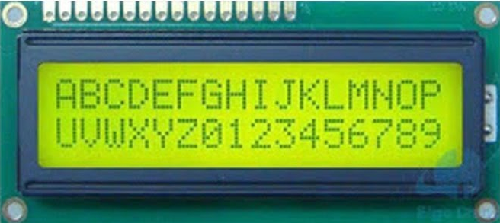



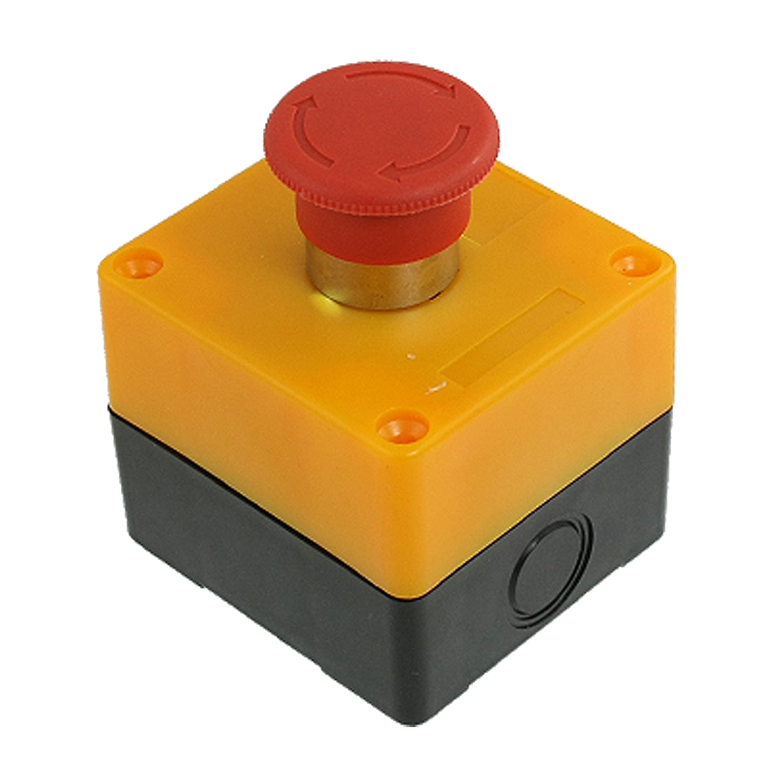
Components of the Solution
101010010101
Cycle
Windows
Toggle
Mute
Toggle
Camera
External
Wireless
PC software to
hardware
protocol
control teams

Slide 3
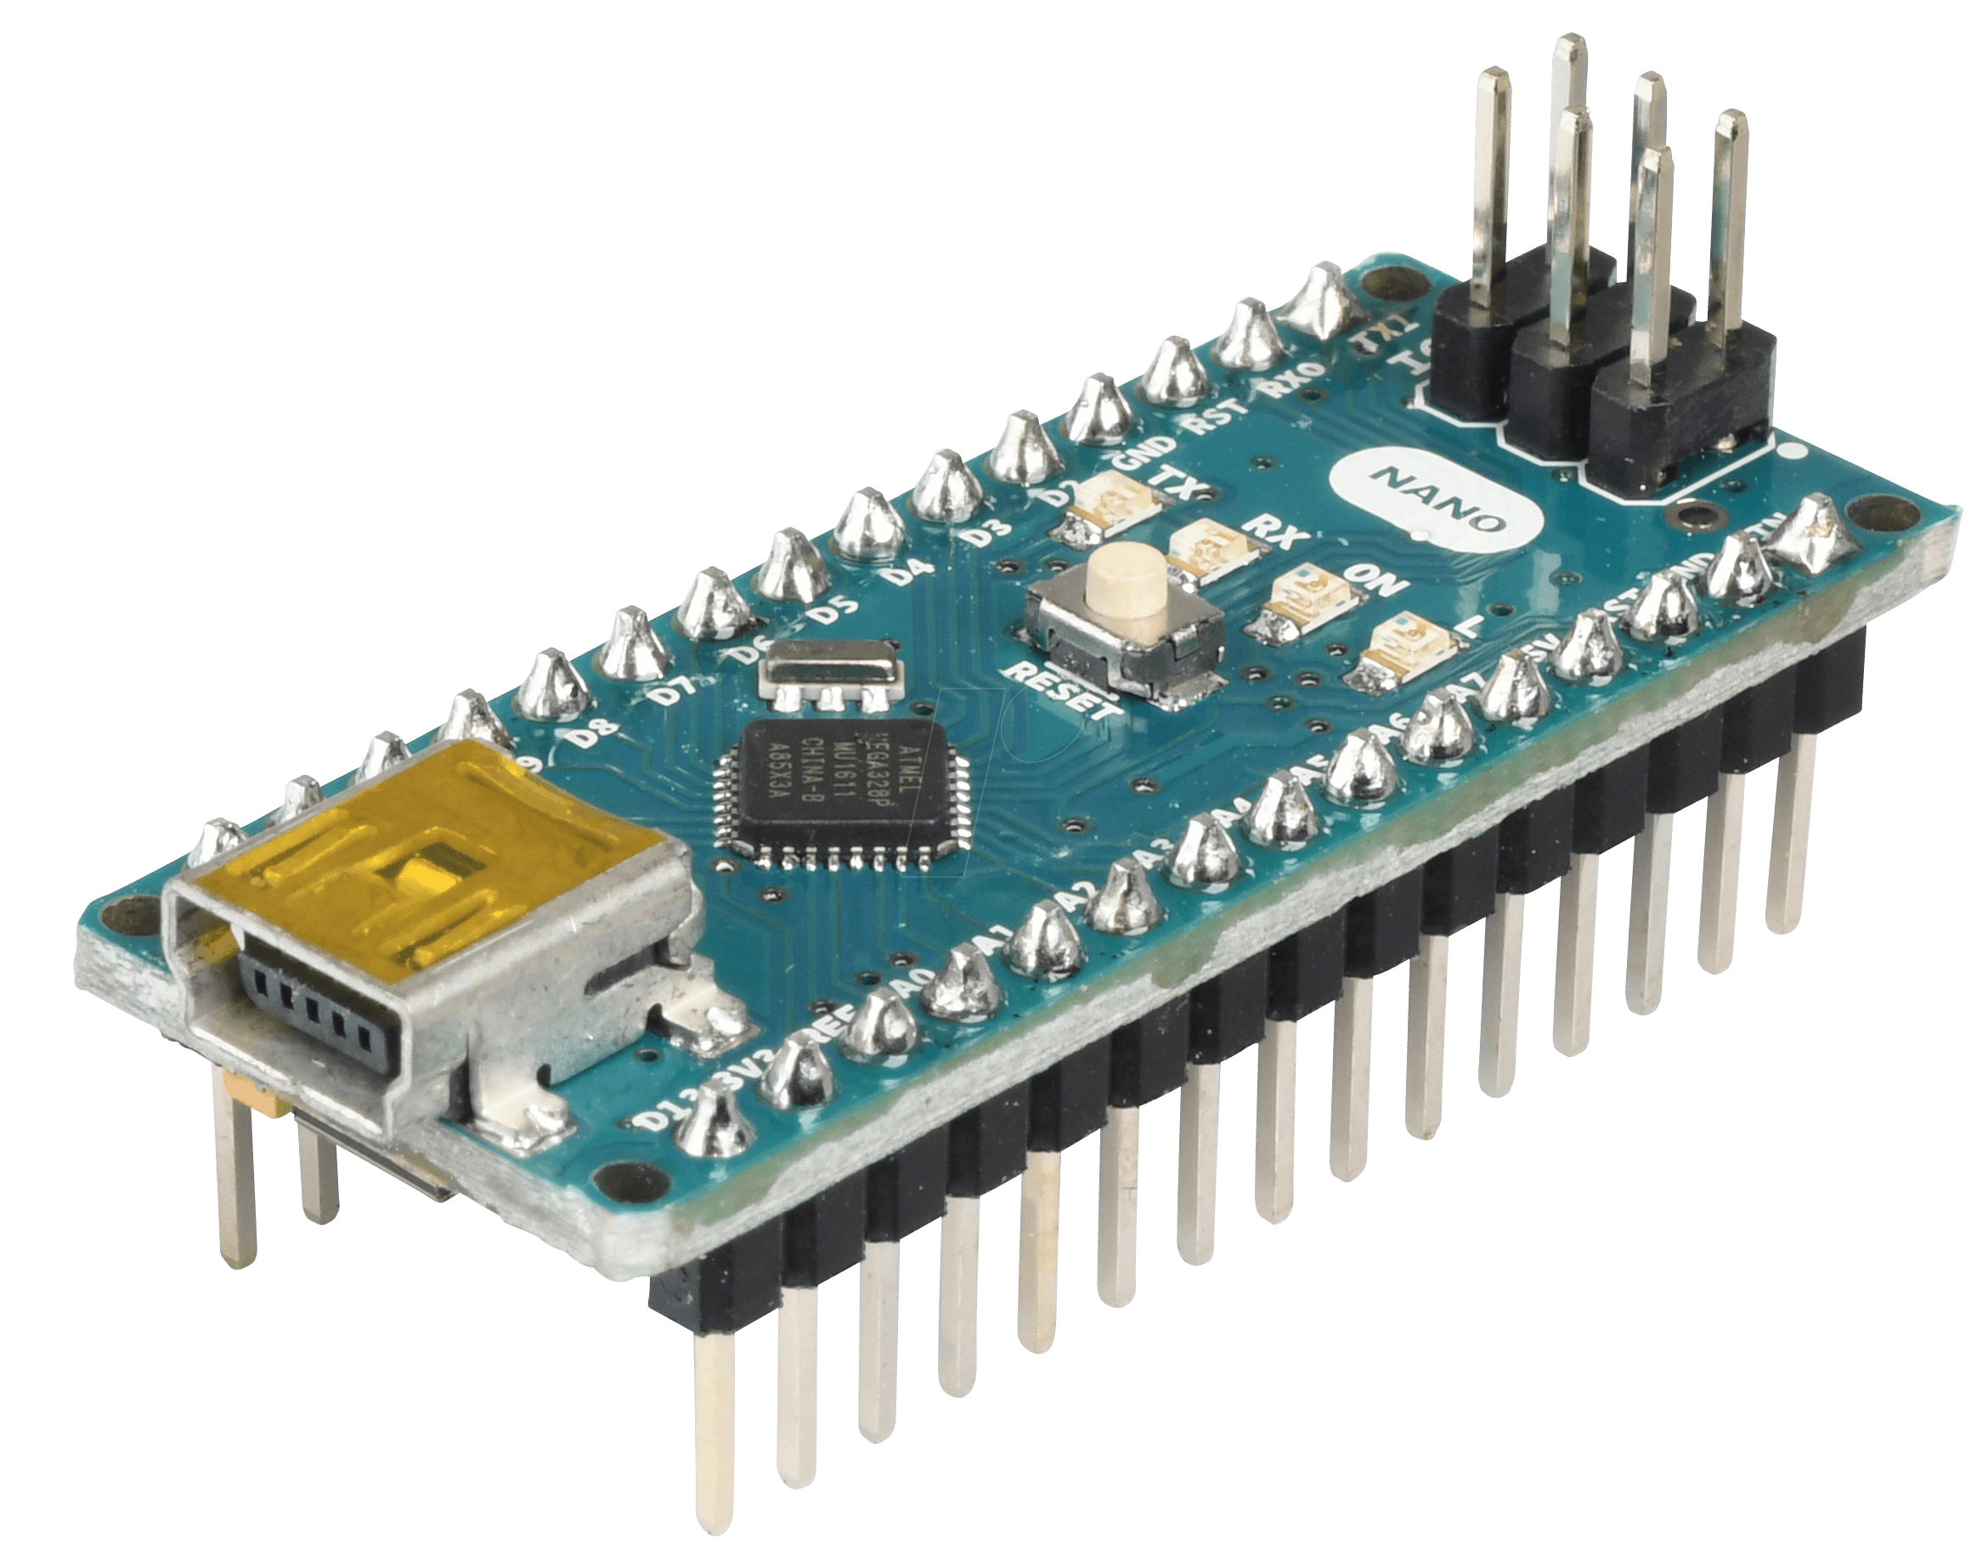
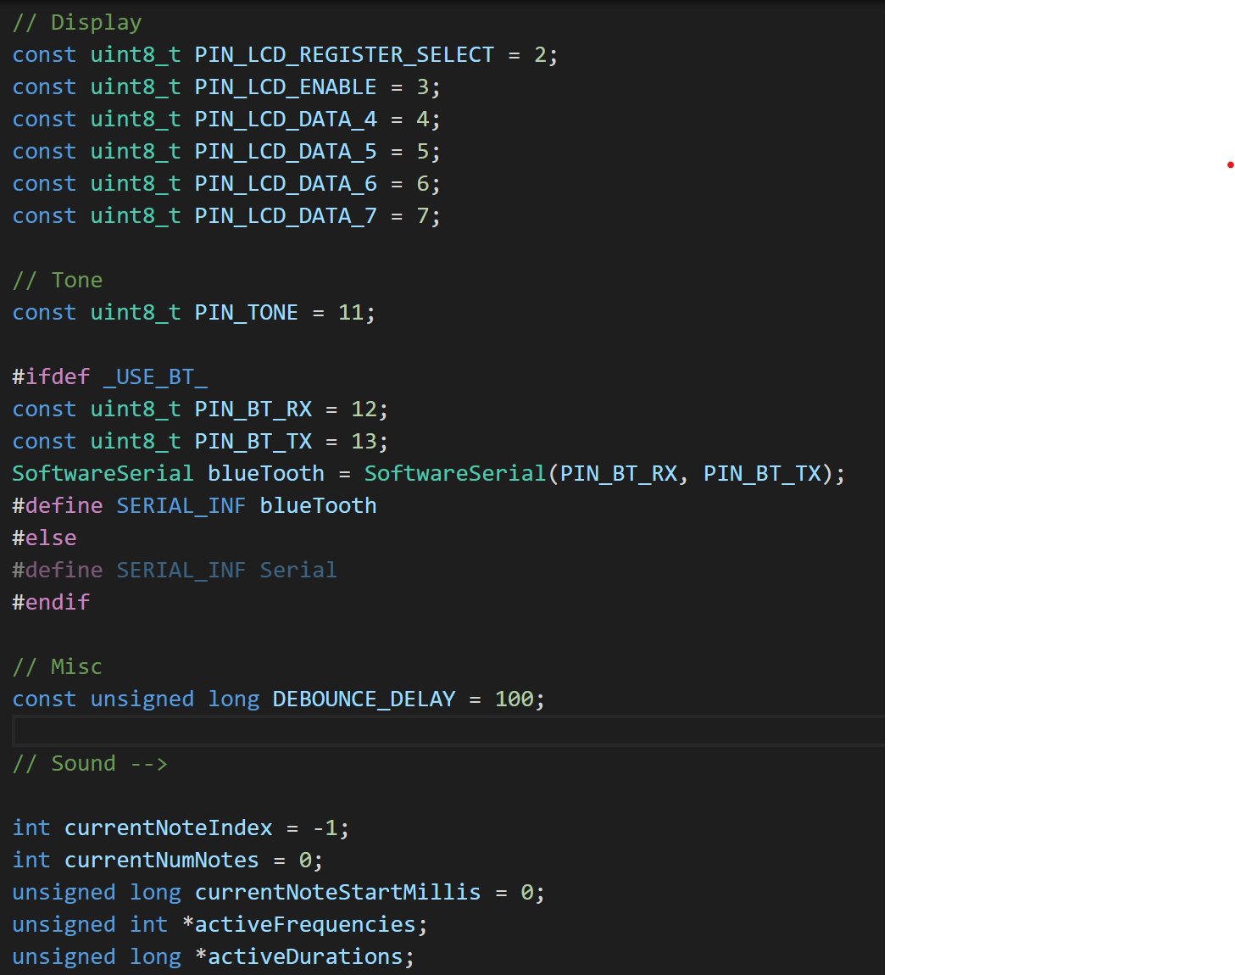
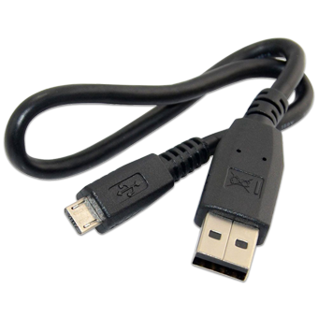
Hardware - Microcontroller
C++
Arduino Nano
Compile
ATmega328 Microcontroller
32K Flash
2K DRAM
14 digital I/O pins
8 Analogue I/O pins
40 mA per pin
Upload

Slide 4
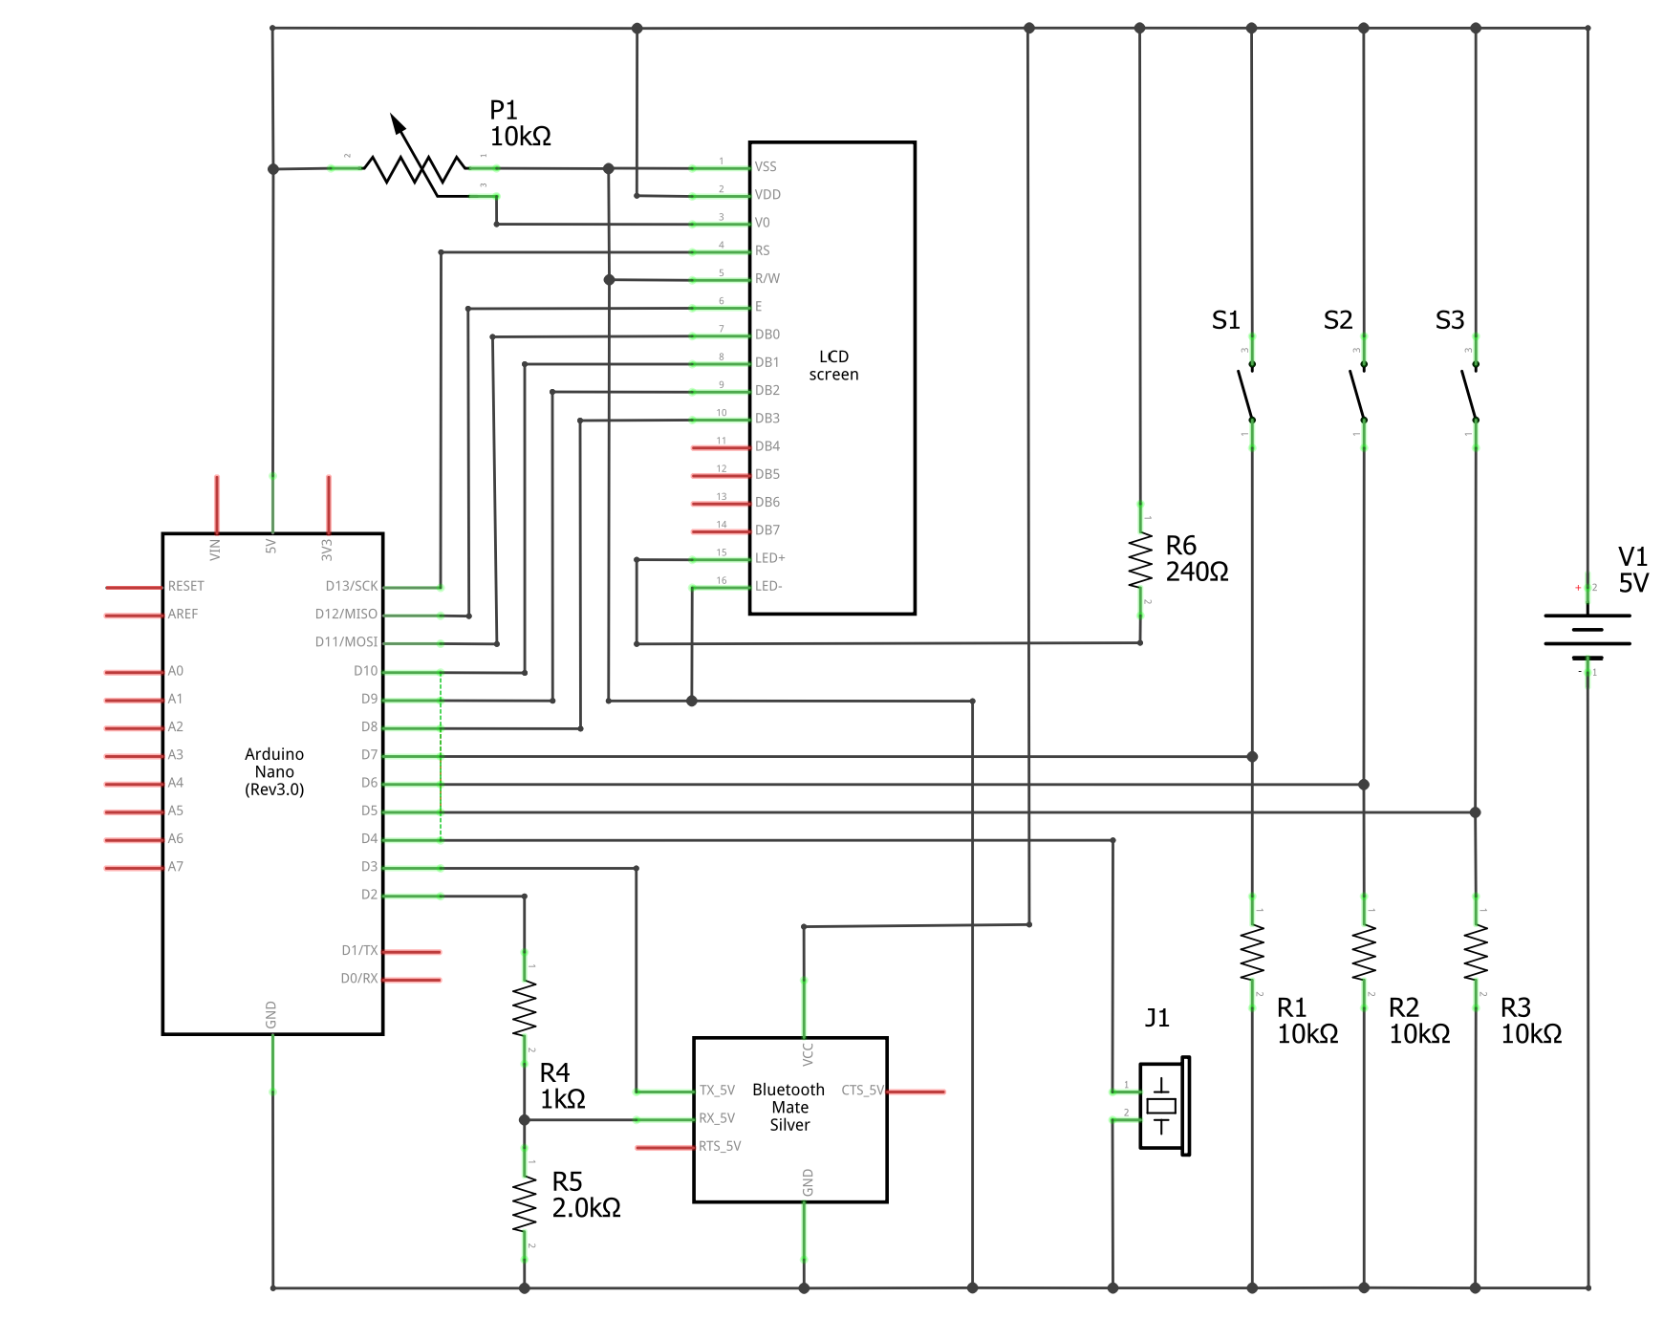
Hardware - Schematic
P1 – LCD contrast
LCD
S1 – Cycle
S2 – Mute
S3 - Camera
R6 - Current limiting resistor for LED backlight
Arduino Nano
R1, R2, R3 - Pulldown resistors
Bluetooth/ HC-05
R4, R5 - Voltage divider
J1 – Piezo buzzer

Slide 5
Hardware - Reality

Slide 6
Protocol

Slide 7
PC Software

Slide 8
Tracing an Example

Slide 9
Demo

Slide 10
Bill of Materials
Wired/USB
Wireless/Bluetooth
Component | # | Total Cost
Arduino Nano | 1
LCD Display | 1
Resistors | 6
Potentiometer | 1
Switch | 3
Piezo Buzzer | 1
Component | # | Total Cost
HC-50 | 1
Battery Power
Component | # | Total Cost
Buck Converter | 1

Slide 11
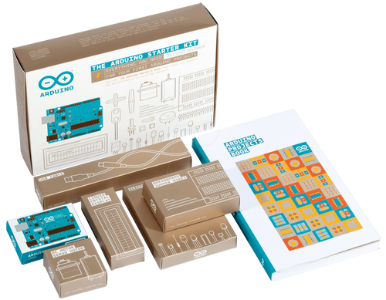
Try Yourself?
The
Arduino
Starter
Kit

